Slide 1
PUTATIVE ROLE OF ADIPOCYTOKINES IN DIABESITY

Slide 2
Diabesity-encompasses-
obesity
insulin resistance
Metabolic Syndrome
T2 Diabetes Mellitus
a growing public health concern having assumed epidemic proportions worldwide

Slide 3
obesity-WHO CRITERIA
Overweight and obesity are defined as abnormal or excessive fat accumulation that presents a risk to health.
A crude population measure of obesity is the body mass index (BMI), a person’s weight (in kGs) divided by square of his or her height (in metres).
A person with a BMI of 30 or more is generally considered obese.
A person with a BMI equal to or more than 25 is considered overweight.

Slide 4
Diabetes Mellitus Type 2(T2DM)
DIAGNOSTIC CRITERIA
In 1997, Expert Committee on the Diagnosis and Classification of Diabetes Mellitus published a new classification scheme and revised diagnostic criteria for diabetes mellitus (criteria 2013 revision).
Classification of Diabetes Mellitus
Diagnostic elements:
genetic markers;
autoantibodies,
clinical characteristics (ketosis, pattern of progression, obesity, age and treatment response)

Slide 5
Diabetes Mellitus Type 2(T2DM)
Classification of Diabetes Mellitus
Type 1: β-cell destruction usually leading to absolute insulin deficiency
Type 2: Insulin resistance with insulin secretion deficiency.
90 - 95% of people who have diabetes have Type 2.
Other specific types:
Genetic defects in β-cell function
Genetic defects in insulin action
Exocrine pancreas diseases
Endocrinopathies
Drug- or chemical-induced
Infections
Other rare forms
Gestational
Screen at 24-28 weeks
75g OGTT: fasting: ≥ 92mg/dl (5.1 mmol/l) ; OR
1 hr: ≥ 180mg/dl (10.0 mmol/l); OR
2 hr: ≥ 153mg/dl (8.5 mmol/l).

Slide 6
Diabetes Mellitus Type 2(T2DM)
DIAGNOSTIC CRITERIA :
Any finding falling within a positive criteria should be repeated on a subsequent day with another test in any criteria set: e.g., a random plasma glucose with symptoms, might be followed-up with a fasting plasma glucose.
Fasting plasma glucose (FPG) ≥ 126 mg/dl (7.0 mmol/l) OR
Symptoms (such as polyuria, polydipsia, unexplained weight loss) AND
a random plasma glucose ≥ 200 mg/dl (11.1 mmol/l) OR
Plasma glucose ≥ 200 mg/dl ( 11.1 mmol/l) 2 hours after a 75g glucose load
OR
A1C ≥ 6.5%.

Slide 7
Diabetes Mellitus Type 2(T2DM)
DIAGNOSTIC CRITERIA :
Categories of increased risk for diabetes (PREDIABETES ):
Fasting plasma glucose (FPG) levels:
100 to 125mg/dl (5.6 - 6.9mmol/l) [IFG];
OR
2-h PG values in the 75-g oral glucose tolerance test (OGIT)): 140 mg/dl to 199 mg/dl (7.8 - 11.0 mmol/l) [IGT];
OR
A1C: 5.7 - 6.4%.

Slide 8
DIABETES SCENARIO
WORLDWIDE DIABETES MELLITUS HAS ALREADY REACHED EPIDEMIC STATUS IN THIS FIRST QUARTER OF THE 21ST CENTURY !
&
~50%diabetics live in china & INDIA
CHINA :98.4 million
INDIA :65.1 million
USA: 24.4million

Slide 9
Diabetes : Scenario (WHO;ICMR;CDC;HIS)
WORLDWIDE
ALARM
~90% Diabetics – Type 2
171 million diabetics in 2000 to double by 2030 Maximum increase in India
1995 to 2025-estimate : Adult diabetics will increase
64% (developed countries)& 170 % (developing countries )
ALREADY
9% adult population suffers from Diabetes(2014US) Diabetes is direct cause of 1.5 million deaths (2012)- 80% deaths BEING in LMIC

Slide 10
INDIA : Diabetes Capital of world !

Slide 11
INDIA : Diabetes Capital of world
40.9 MILLION DIABETICS IN 2007 ESTIMATED TO RISE TO 69.9 MILLION DIABETICS IN 2030
V. Mohan.,et al (2007 ICMR Study )
50.8 MILLION DIABETICS IN 2010 ESTIMATED TO RISE TO 65.1 MILLION DIABETICS IN 2030
(IDF Diabetes Atlas 6th ed 2013)
ABOUT 109 THOUSAND DEATHS REPORTED IN INDIA DUE TO DIABETES MELLITUS IN 2004
Venkataraman K et al.,2009. Intl. J of Diabetes in Developing Countries

Slide 12
INDIA : Diabetes –A Serious Concern POTENTIAL EPIDEMIC
Diabetes is serious concern warranting research at both community & basic level
ICMR and other agencies have funded a lot and research is going on
BUT CONSORTIUM BASED PREVALENCE STUIDES ARE NEED OF HOUR
TILL NOW ICMR –INDIAB COORDINATED STUDY HAS TAKEN PLACE

Slide 13
REGIoNAL Prevalence STUDIES SHOW
HIGHEST KERALA -19.5%
LOWEST KASHMIR VALLEY --6.1%
--Zargar AH et al.,2000. Diabetes Research and Clinical Practice
Javid Ahmad et al , Al Ameen J Med S ci (20 1 1 )4 (1 ):3 8 -4 4

Slide 14
METABOLIC SYNDROME
CLUSTERING OF SYMPTOMS, ABNORMALITIES, AND METABOLIC RISK FACTORS COMMONLY OBSERVED AND TERMED AS SYNDROME X BY G. REAVEN IN 1988
PREDISPOSING TO CVD , INSULIN RESISTANCE PRIMARILY UNDERLIES IT
ALSO CALLED INSULIN RESISTANCE SYNDROME & THERE IS INCREASED RISK FOR T2DM
THE TERM METABOLIC SYNDROME FOR THIS CLUSTERING OF METABOLIC RISK FACTORS IS PREFERRED AS IT AVOIDS THE IMPLICATION THAT INSULIN RESISTANCE IS PRIMARY OR ONLY CAUSE OF ASSOCIATED RISK FACTORS ATP III USES THIS ALTERNATIVE TERM

Slide 15
Individuals with metabolic syndrome seemingly are susceptible to other conditions also notably polycystic ovary syndrome, fatty liver, cholesterol gallstones, asthma, inflammation , sleep disturbances, and some forms of cancer.

Slide 17
METABOLIC SYNDROME :
CLUSTERING TOGETHER OF SYMPTOMS, ABNORMALITIES & METABOLIC RISK FACTORS INCLUDING HYPERLIPIDEMIA, ABDOMINAL OBESITY, INSULIN RESISTANCE, HYPERTENSION
AT LEAST 3 MAJOR ORGANIZATIONS HAVE RECOMMENDED CLINICAL CRITERIA FOR DIAGNOSIS OF METABOLIC SYNDROME.
* National Heart, Lung, and Blood Institute(NLHBI)and American Heart Association(AHA)Adult Treatment Panel (ATP III ) criteria
*World Health Organization criteria (WHO)
*American Association of Clinical Endocrinologists(AACE) criteria
Their criteria are similar in many aspects, but they also reveal fundamental differences in positioning of the predominant causes of the syndrome
In our studies we followed ATP III criteria giving priority to abdominal obesity as contributor to metabolic syndrome.

Slide 18
Those who fulfill AT LEAST THREE of following five criteria of MetS will be defined as “affected” for MetS according to ATPIII criteria.
THE FIVE CRITERIA INCLUDE
blood pressure ≥ 130/85 mmHg
Fasting plasma glucose level >110 mg/dL
Hypertriglyceridemia with triglyceride level ≥150 mg/dL
(4) High-density lipoprotein-cholesterol (HDL-C) level <1.0 mmol/l in men or <1.3 mmol/l in women
(5) Central obesity with waist circumference >90 cm in men or >80 cm in women

Slide 19
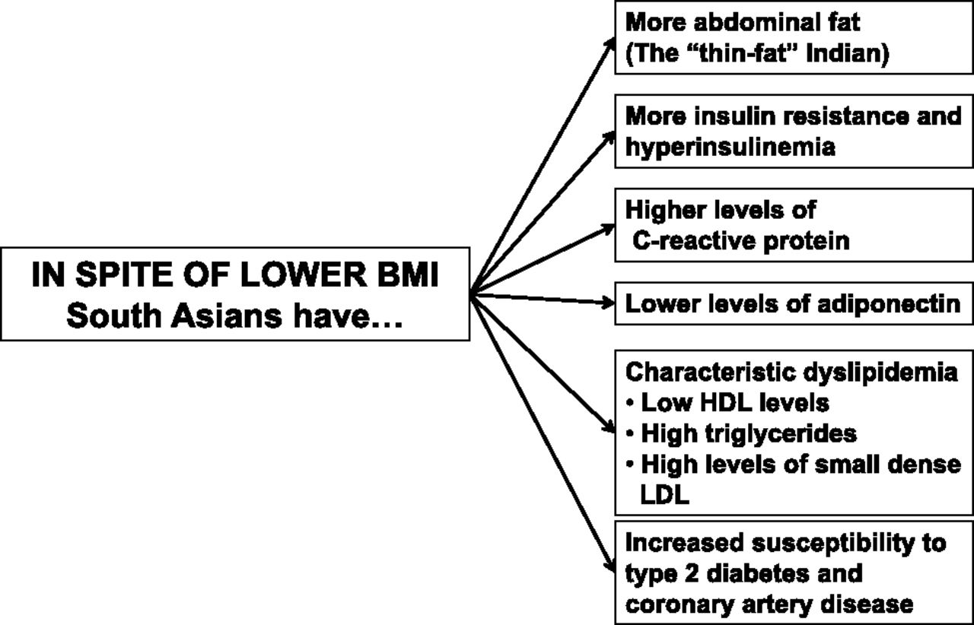
THE SOUTH ASIAN (“ASIAN INDIAN”) PHENOTYPE
Ranjit Unnikrishnan et al. Diabetes 2014;63:53-55
©2014 by American Diabetes Association
Notes:
The South Asian (“Asian Indian”) phenotype.

Slide 20
“ASIAN INDIAN PHENOTYPE” –
MAKES ASIAN INDIANS PRONE TO DIABETES
Diabetes is a lifestyle disorder .
Increasing obesity in South Asians is primarily by nutrition / lifestyle changes , physical inactivity & demographic transactions in background of genetic predisposition and fetal programming

Slide 21
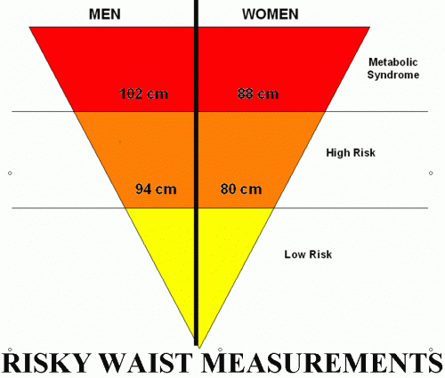
Modified ATP-III criteria Asian-specific –
90 cm in men & 80 cm in women used in recent Asian and Indian studies

Slide 22
Diabesity-encompasses-
obesity
insulin resistance
Metabolic Syndrome
T2 Diabetes Mellitus
a growing public health concern having assumed epidemic proportions worldwide

Slide 23
ADIPOCYTES
Adipose tissue is not merely an energy storage organ but an important endocrine organ
Secreting many biologically active substances such as leptin, free fatty acids (FFAs), tumor necrosis factor-a (TNF-a), Adiponectin etc. collectively termed ADIPOCYTOKINES
Recently, endocrine aspects of adipose tissue have become an active research area

Slide 24
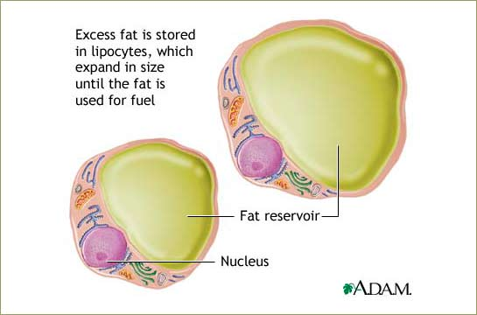

Slide 25
Role of various adipocytokines and inflammatory state has been implicated in diabesity.
A complex interaction among multiple genetic variants and environmental risk factors underlies T2DM and MetS .

Slide 26
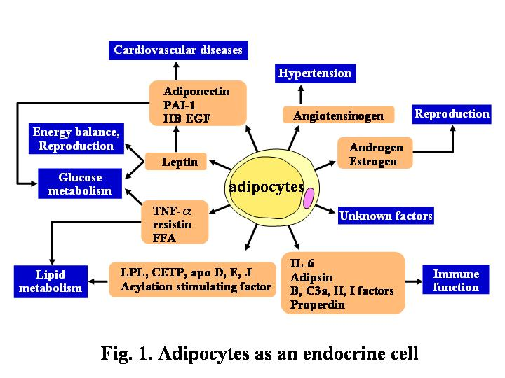
Adipocytes and adipocytokines
ADIPOCYTOKINES

Slide 27
CYTOKINES AND DIABETES
LOW GRADE INFLAMMATION & DIABETES :
Evolutive advantages of increased inflammatory responses, hypersecretion of proinflammatory cytokines [tumor necrosis factor-alpha (TNF-alpha), interleukin (IL)-1beta, IL-6, and IL-18], or decreased anti-inflammatory molecules (adiponectin, certain TNF-alpha isoforms, soluble CD14, etc.) can lead to chronic inflammation conditions predisposing to obesity, type 2 diabetes & CVD

Slide 28
Dysregulation of pro- & anti-inflammatory adipocytokine function & production seen in visceral fat obesity is associated with metabolic syndrome
Suggesting -Inflammation may critically contribute to development of metabolic syndrome and related pathologies
LOW GRADE INFLAMMATION

Slide 29
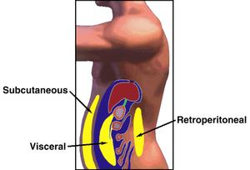

Slide 30
ADIPOKINES
INSULIN RESISTANCE & TYPE 2 DIABETES
ADIPONECTIN: Causes modulation of glucose and fatty acid metabolism.
RESISTIN: Increases LDL levels and also degrades LDL receptors in the liver , it accelerates the accumulation of LDL in arteries, thus increases the risk of heart disease. Besides, resistin adversely impacts the effects of statins and prevention of cardiovascular disease.
LEPTIN: Stimulate glucose uptake and fatty acid oxidation in skeletal muscle to prevent lipid accumulation in tissues such as skeletal muscle, liver, and pancreatic β-cells

Slide 31
ADIPOKINES : missing link between insulin resistance and obesity!
Dysregulated
adipokine synthesis & LOW GRADE INFLAMMATION - the inter tissue cross-talk they mediate Could underlie Metabolic syndrome & diseases towards which it predisposes

Slide 32
Study on Adiponectin Levels & ADIPOQ Gene Polymorphism in Type 2 Diabetes Mellitus Patients of Kashmir Valley –DST Funded

Slide 33
ADIPONECTIN LEVELS MEASURED BY ELISA
COMPARATIVE HOSPITAL BASED STUDY IN KASHMIRI POPULATION
GROUP I : Obese with T2DM ;N= 150
GROUP II: Obese without T2DM;N=150
GROUP III: Non obese with T2DM;N=100
Group IV : Normal Healthy Volunteers ;N=300

Slide 34
ADIPONECTIN THE WONDER REGULATOR- A NOVEL ADIPOKINE
AN IMPORTANT REGULATOR OF LIPID & GLUCOSE METABOLISM - OBSERVED DECREASED LEVELS IN T2DM , OBESITY, INSULIN RESISTANCE , CAD & MET S
IT HAS ANTIDIABETIC & ANTIATHEROGENIC EFFECTS & COULD BE NOVEL THERAPEUTIC TOOL FOR DIABETES AND METS
Its higher levels are being associated with health benefits

Slide 35
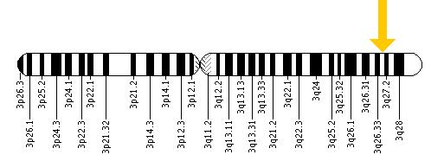
Adiponectin is encoded by the ADIPOQ gene on chromosome 3q27, a region identified on susceptibility locus for the Met S and T2DM by genome wide scans.
This gene contains 3 exons. The
translation start point is located in
exon 2.

Slide 36
SNP’s OF ADIPOQ Gene
A total of 24 SNPs in the adiponectin gene were successfully genotyped in diabetic nephropathy
Ma J et al. J Diabetes Complications. 2007;21(1):28–33.
The strongest associations are seen in two promoter single nucleotide polymorphism (SNPs) −11,377C>G and −11,391G>A, the exon 2 synonymous SNP +45T>G, and the intronic SNP Meredith A et al.,2009.Diabetes
Putative functional SNP (pf-SNP) +276G/T and promoter polymorphisms in SNP +45T>G of ADIPOQ gene are associated with decreased plasma adiponectin levels in T2D,T1D,NASH
Hara K,et al.,(2002).,Ma J .,et al(2007)).

Slide 37
Association of SNP +45 T>G and + 276 G>T in ADIPOQ gene with T2DM in Kashmiri population
Group 1: Type 2 DM ; N=50
Group 2 : Normal Healthy Volunteers; N= 50

Slide 38
LOW ADIPONECTIN LEVELS were found to be significantly associated with Type 2 diabetes mellitus.
HIGH ADIPONECTIN LEVELS were protective
Greater decrease in Adiponectin levels in obese/ obese diabetics than in lean diabetics
LOW ADIPONECTIN levels correlate with obesity

Slide 39
Recent Research Trends
STUDIES AIMED TO EVALUATE ROLE OF ADIPOCYTOKINES IN T2 DM & MetS To ESTABLISH IT AS THE MOLECULAR LINK
STUDYING EPIGENETIC & GENETIC CHANGES OF ADIPOKINE GENES WITH ULTIMATE COULD PREDICT MODULATIONS LEADING TO ALTERED ADIPOKINE LEVELS
ESTABLISHING ADIPOCYTOKINES AS DRUGS - AS MAJOR GOAL OF CONTEMPORARY RESEARCH INTO DIABETES MELLITUS IS TO DEVELOP TREATMENT REGIMENS TO DECREASE ITS PREVALENCE THEREBY MAXIMIZE SURVIVAL.
ESTABLISHING CIRCULATING ADIPOCYTOKINE LEVELS AS HIGH- THROUGHPUT EARLY BIOMARKERS TO ASSESS Diabesity including ,T2DM & MetS

Slide 40
ROAD AHEAD …
TO IDENTIFY VARIOUS ADIPOKINES ,THEIR POSSIBLE MODULATION . STUDY MOLECULAR BASIS OF LINK BETWEEN OBESITY AND ASSOCIATED DISORDERS THAT IS , MET SYNDROME , ATHEROSCLEROSIS, INFLAMMATION & PCOD
USE OF CIRCULATING LEVELS OF ADIPOKINES AS HIGH-THROUGHPUT BIOMARKERS TO ASSESS ALL OBESITY RELATED HEALTH PROBLEMS
IDENTIFYING POTENTIAL DRUGS AND DRUG TARGETS FOR OBESITY AND RELATED DISORDERS

Slide 41
Ultimately consortium’s need to be established
Studies are needed where levels of adipokines , their genetic & epigenetic alterations in not only T2DM , CVD but also in PCOS, Thyroid disorders , inflammation & cancers is studied in detail.
Mechanistic basis of damage caused by obesity & MetS needs to be unravelled prevented & cured .

Slide 42
Thank you

Slide 43
BACKUP SLIDE

Slide 44
ELISA Plate (Adiponectin)

Slide 45
ELISA Reader and Washer

Slide 46
RATIONALE
High Incidence
Correlation of Adipokines with diabetes has not been reported so far

Slide 47
IMPORTANCE OF THE PROPOSED PROJECT
Adipokines genetic variation may play a common role in the pathogenesis of diabetes mellitus and other complex diseases like obesity.
A major goal of contemporary research into diabetes mellitus is to develop treatment regimens to decrease its prevalence thereby maximize survival.
The low plasma adiponectin level in metabolic diseases, including diabetes mellitus is an advantage for identification of this disease at an initial stage.
New drugs with greater potential may be discovered keeping in view the changing adipokine levels in T2DM and MetS if any.
By considering role of adipokines and elucidating its mechanism of action, would help to establish adipokines as a drug in future to decrease likelihood of the disease.
The results of the study can lead to a new treatment to increase adiponectin in circulation or prevent the reduction of adiponectin.

